Slide 1
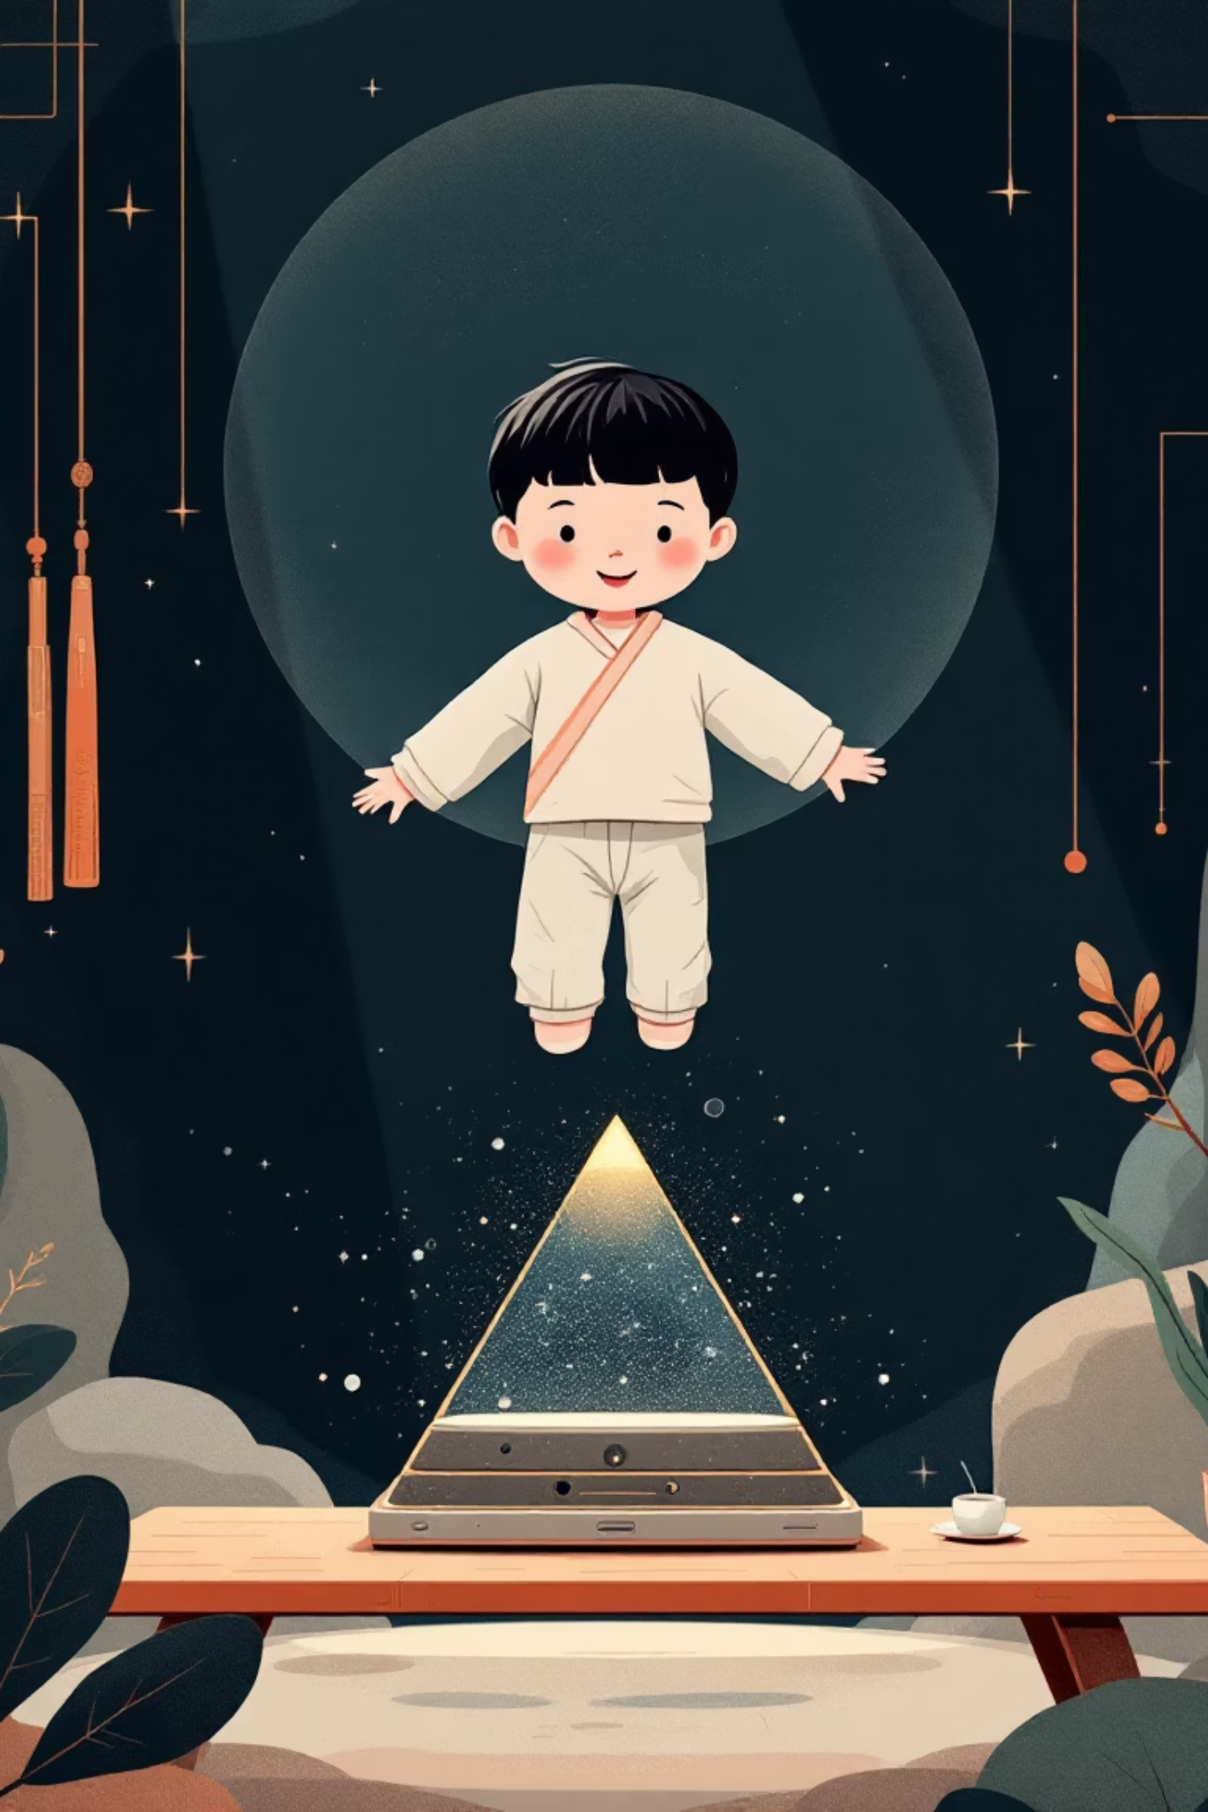
Holographic AI Assistant for Children's Learning
A revolutionary project combining conversational AI, holographic projection, and child-centered design to create immersive learning experiences.
Students: Priyanshu Karki, Tanuja Karki, Chirayu Mahar, Bhupendra Singh Supervisor: Dr. Amit Gupta

Slide 2
The Problem
Flat Interactions
Limited Engagement
Missing Emotional Depth
Children need more than simple screen interactions - they require systems that stimulate curiosity and maintain attention.
Conventional digital assistants are often flat, repetitive, and uninspiring for younger audiences.
Existing tools lack the visual engagement and emotional connection needed to truly connect with children.

Slide 3
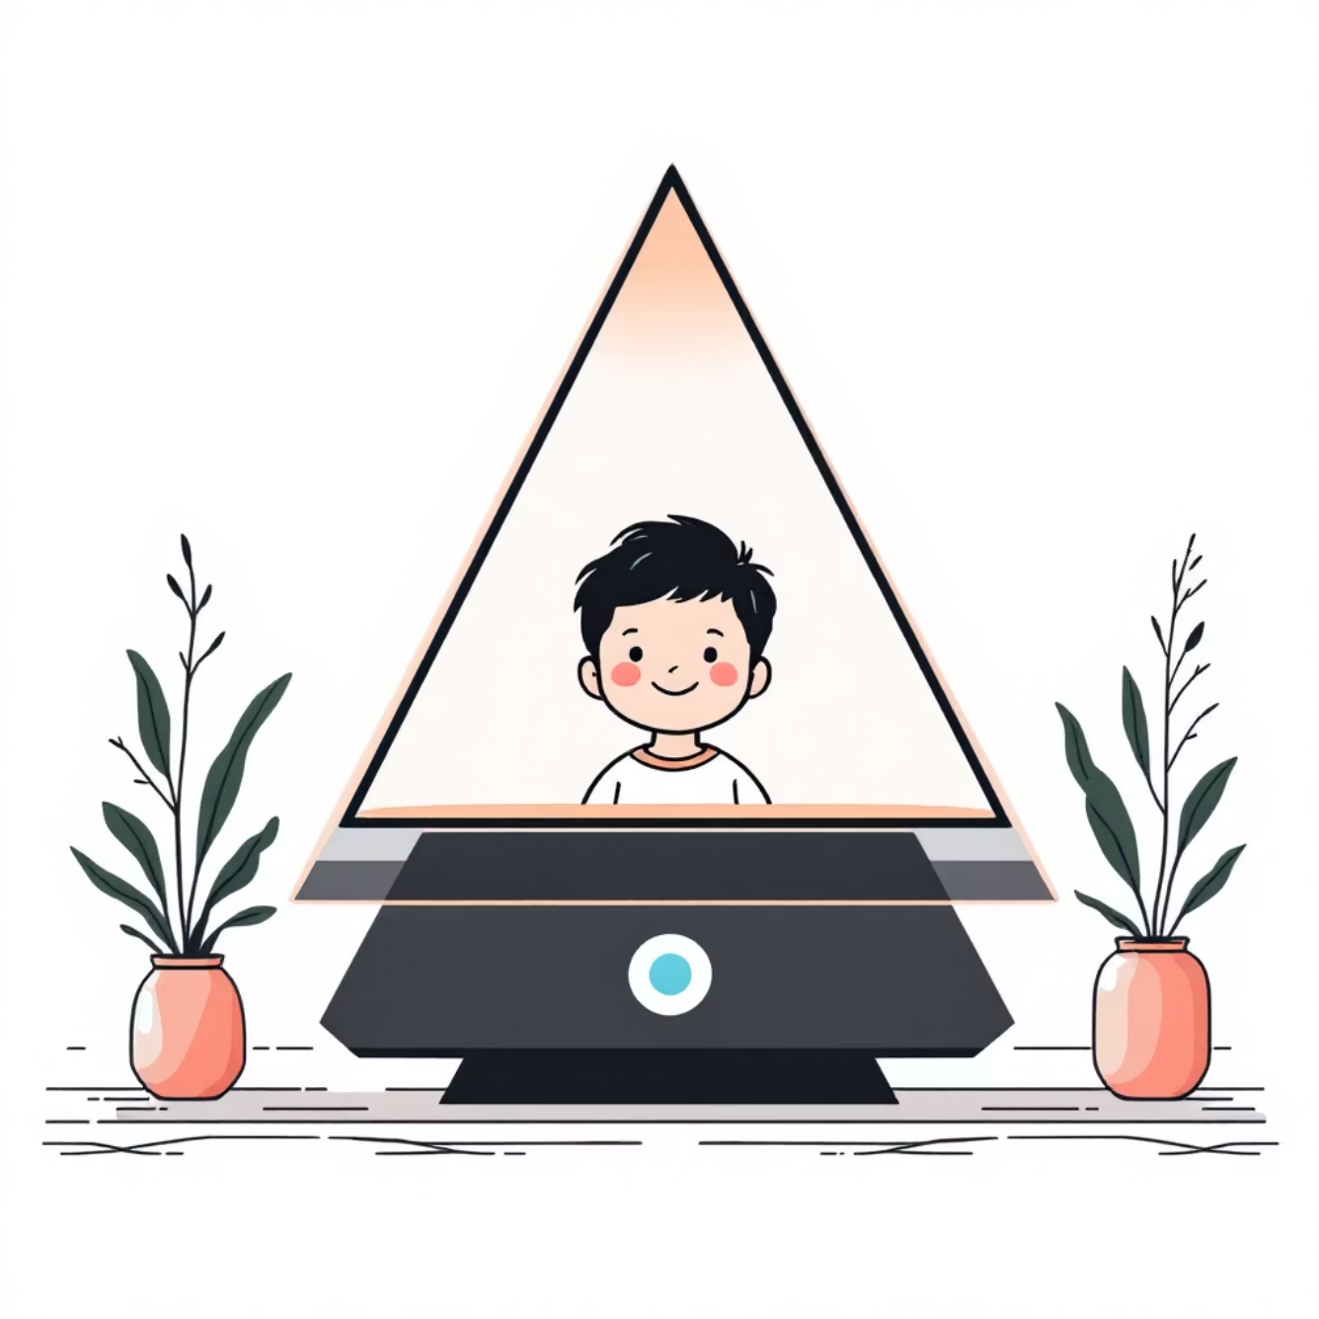
Our Revolutionary Solution
01
Conversational AI
Natural, interactive dialogues powered by ML/NLP models including Rasa, spaCy, and TensorFlow.
02
Pepper's Ghost Holography
Cost-effective 3D holographic presence using simple pyramid projection technique.
03
Lip-Sync Animation
Text-to-Speech with synchronized avatar animation for realistic communication.
04
Child-Centered Design
Age-appropriate interface promoting curiosity, learning, and natural interaction.

Slide 4




Core Technology Stack
ML/NLP Engine
Text-to-Speech
Rasa, TensorFlow/Keras, spaCy, and NLTK power real-time conversational AI with intent recognition and context tracking.
Google TTS, ElevenLabs, and gTTS convert responses into natural-sounding voices with tonal variation.
Avatar Animation
Holographic Display
D-ID and HeyGen create lifelike talking avatars with synchronized lip movements and expressions.
Pepper's Ghost pyramid technique creates 3D illusion using smartphones or tablets for affordable accessibility.

Slide 5





System Workflow
User Input
Children interact via voice or text input
NLP Processing
AI models process input for intent and context
Response Generation
System produces natural language replies
TTS Conversion
Text converted to natural-sounding voice
Holographic Projection
Lip-synced avatar displayed as 3D hologram

Slide 6




Key Project Outcomes
Immersive Telepresence
Context-Aware AI
Life-like holographic avatar creates stronger presence than 2D interfaces, leading to higher attention spans.
Meaningful dialogue capabilities enable questions, explanations, storytelling, and playful exchanges.
Realistic Animation
Cost-Effective Solution
TTS with lip-synced animation creates lifelike experience - avatar feels like living character.
Pepper's Ghost display provides 3D illusion using simple smartphones/tablets - widely accessible.

Slide 7
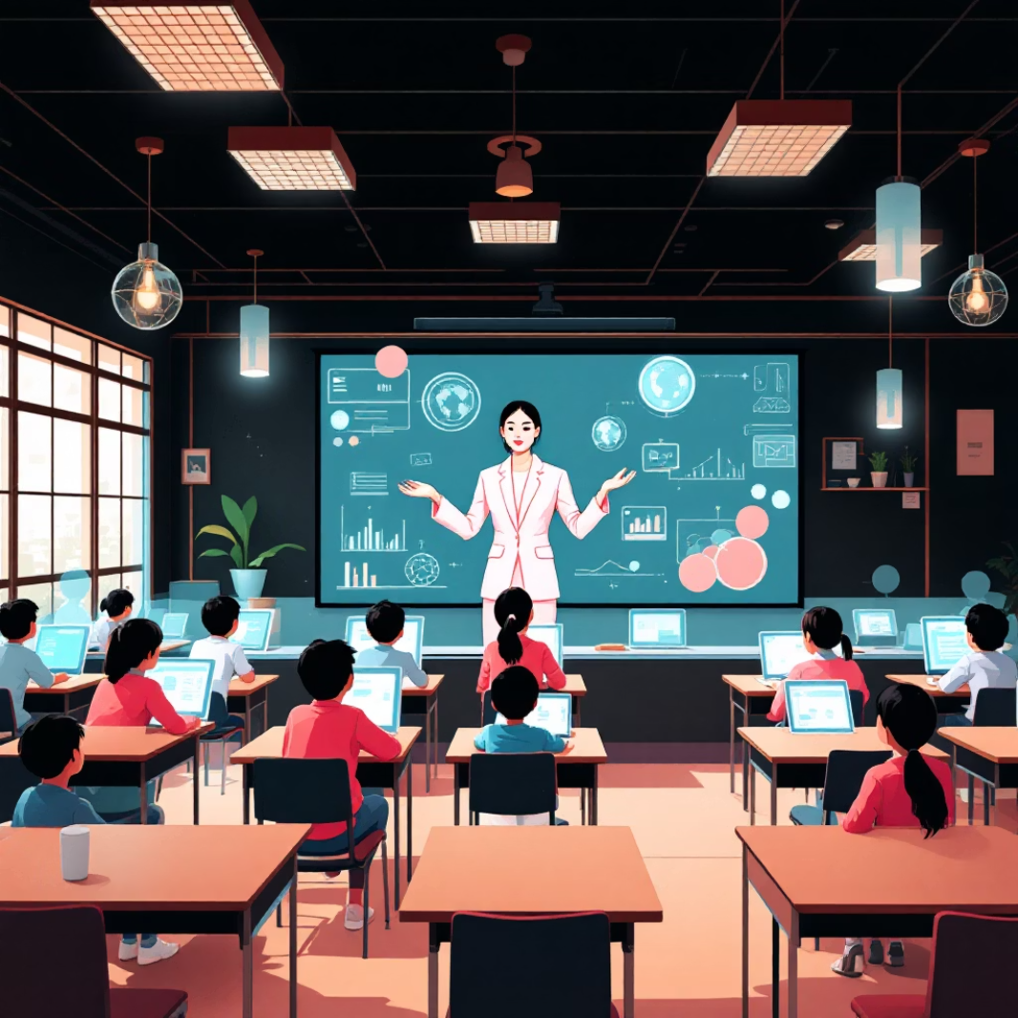
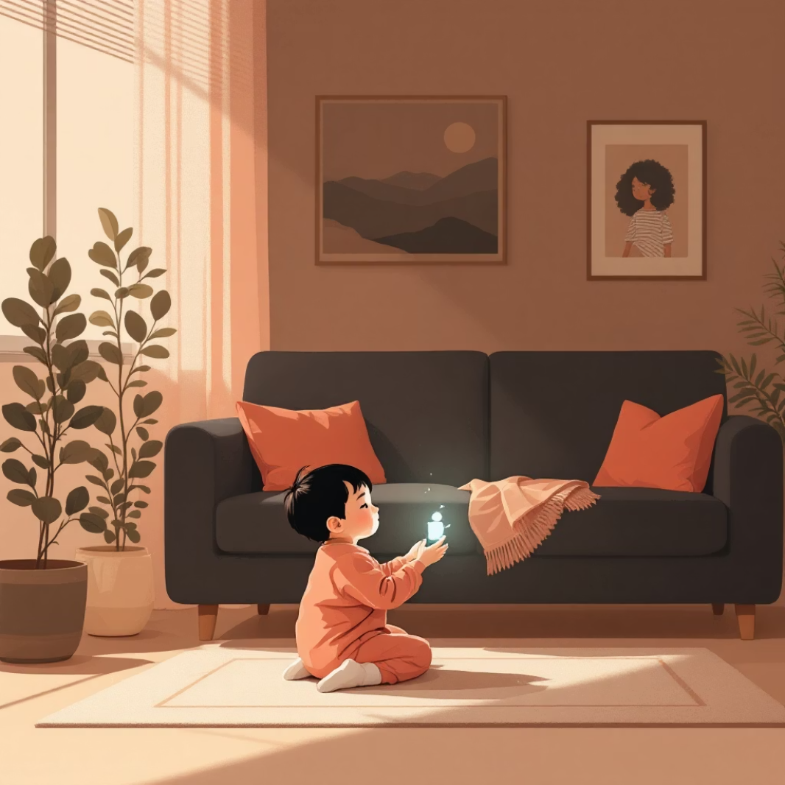
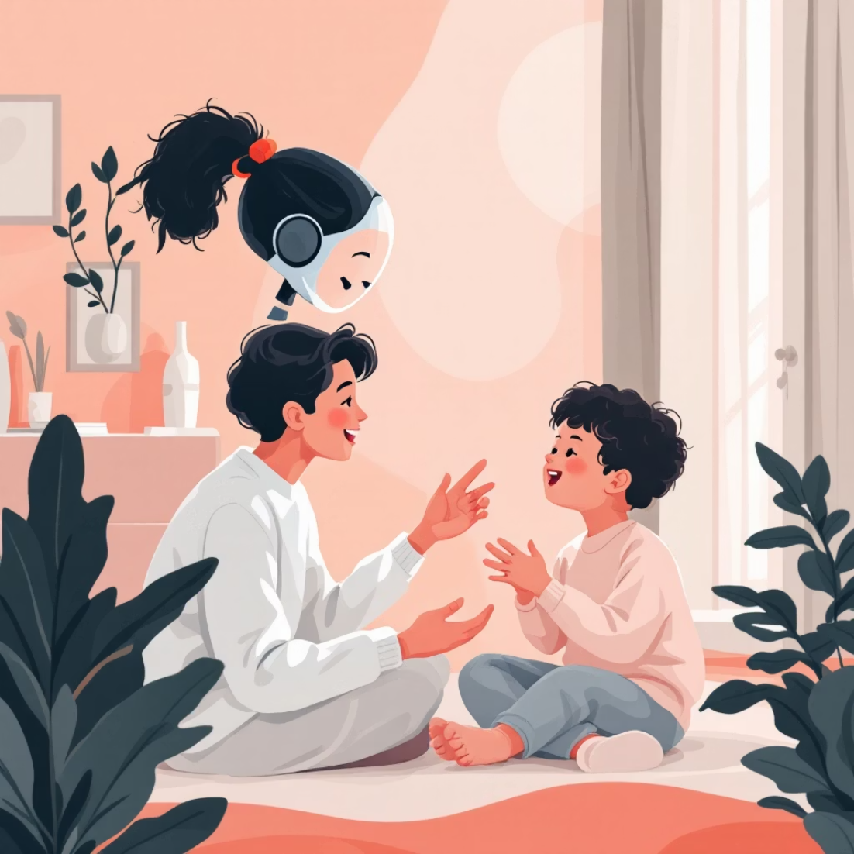
Versatile Applications
Education
Home Use
Special Needs
Interactive lessons
Entertainment companion
Therapeutic support
Storytelling sessions
Playful learning
Assisted learning
Language learning
Digital companionship
Anxiety reduction
Subject-specific modules
Bedtime stories
Communication aid

Slide 8
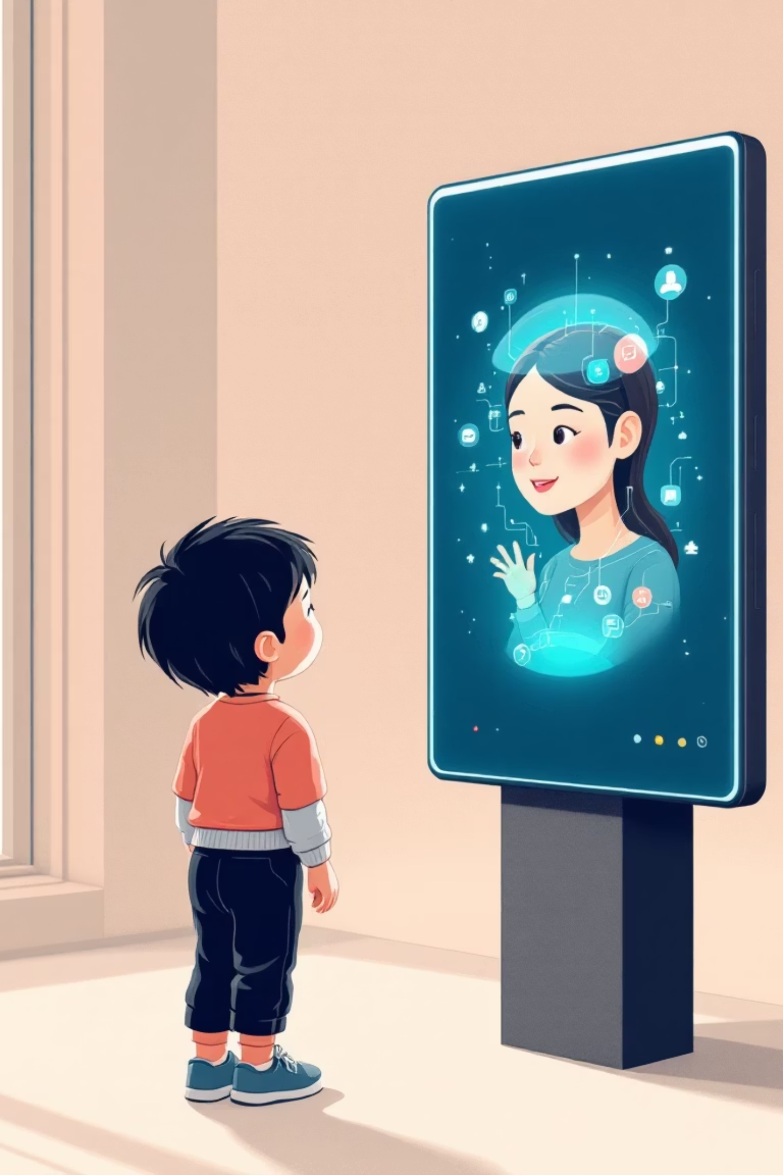



Sample Interaction Scenarios
Educational Interaction
Storytelling Mode
Child: "Tell me about the solar system."Assistant: "The solar system has eight planets revolving around the Sun. Would you like me to show you a 3D view of the planets?"
Child: "Tell me a bedtime story."Assistant: "Once upon a time, there was a brave little bird who wanted to fly higher than the clouds..."
Language Learning
Child: "How do you say hello in Spanish?"Assistant: "In Spanish, hello is 'Hola.' Can you repeat that with me?"

Slide 9
Future Scope & Expansion
Multilingual Support
1
Expansion to include multiple regional and global languages for diverse audiences.
2
Adaptive Learning
Integration with educational content tailored to different age groups and learning styles.
Gesture Recognition
3
Adding non-verbal communication features for richer, more natural interaction.
4
Cloud Integration
Enabling remote access, updates, and collaborative learning features across devices.
Smart Classrooms
5
Interactive lessons where multiple children engage with holographic avatars simultaneously.

Slide 10
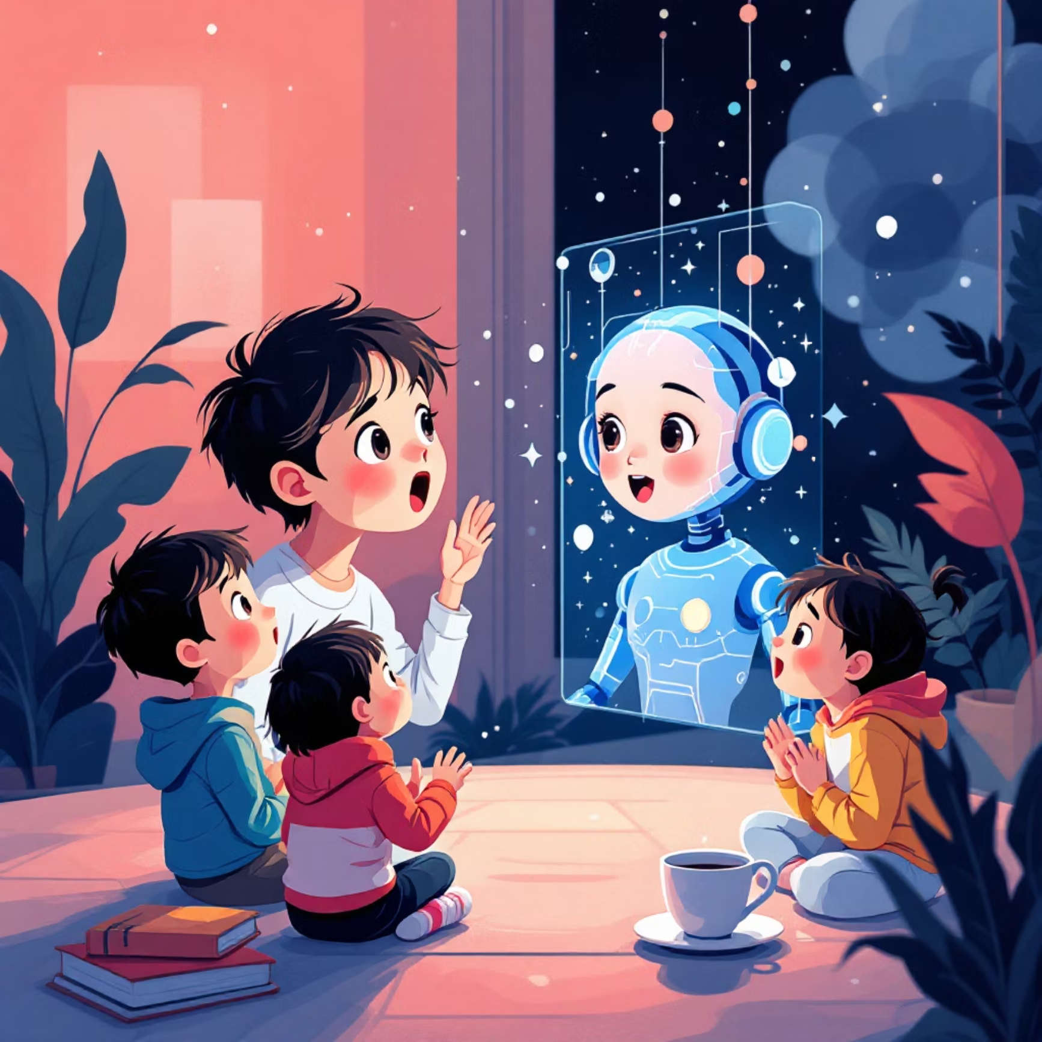
Project Impact
4
3
Core Technologies
Application Domains
AI, holography, animation, and speech synthesis integrated seamlessly
Education, home entertainment, and therapeutic support
100%
Modular Design
Scalable architecture for future AI and holographic innovations
This project demonstrates that AI, ML, and holographic visualization can create feasible, affordable, and safe solutions for modern child-focused telepresence applications.

